Slide 1
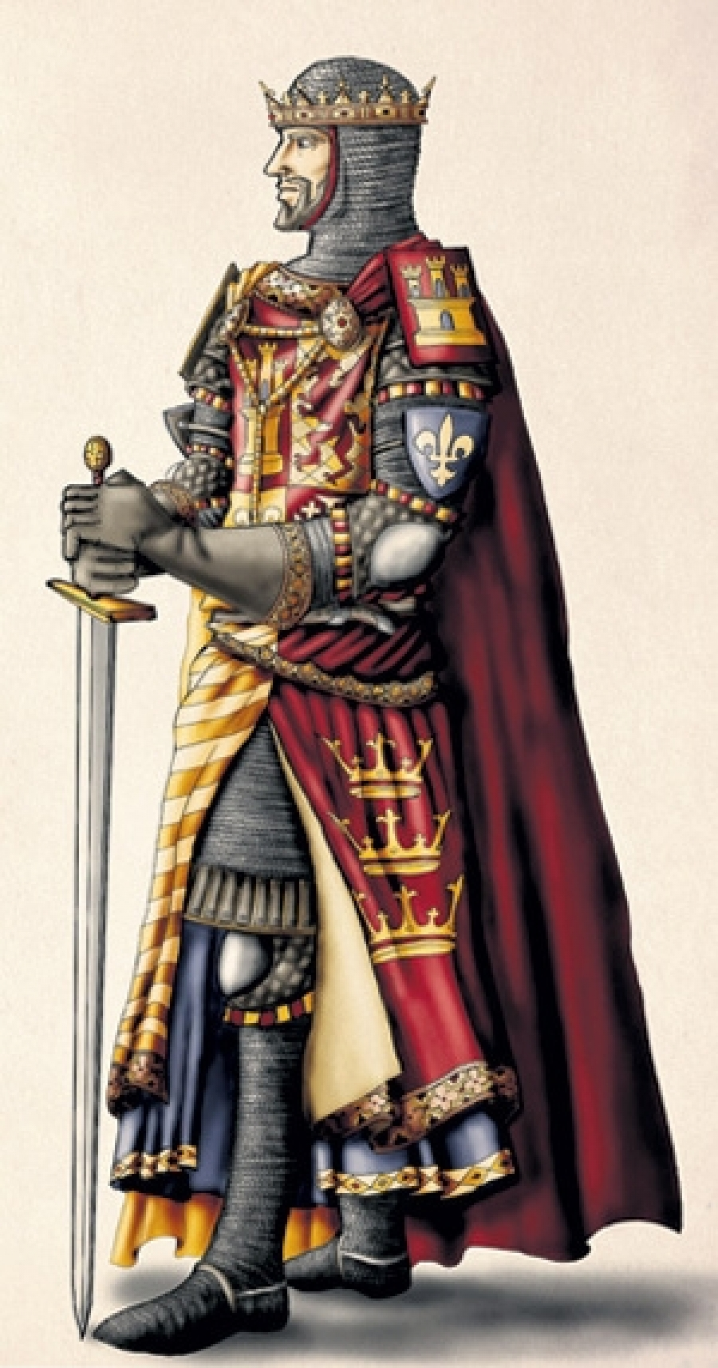
KING Arthur
made by Daniil Savin

Slide 2
KING Arthur
King Artur - according to legends, the ruler of the kingdom of Logres, the legendary leader of the Britons of the 5th — 6th centuries, who defeated the conquerors-Saxons. The most famous of the Celtic heroes, the central hero of the British epic and numerous knightly novels.
made by Daniil Savin

Slide 3
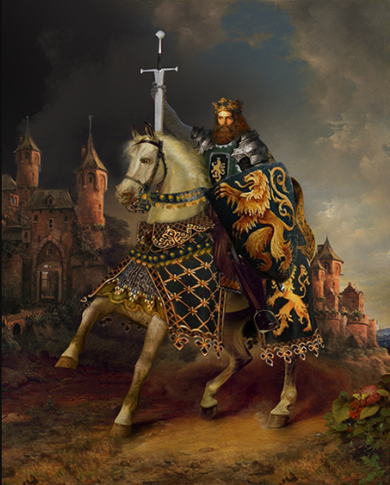
KING Arthur
Chivalry
made by Daniil Savin

Slide 4
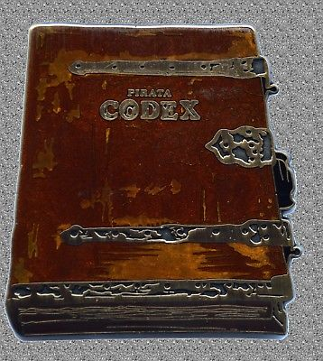
KING Arthur
Сode of Chivalry
made by Daniil Savin

Slide 5
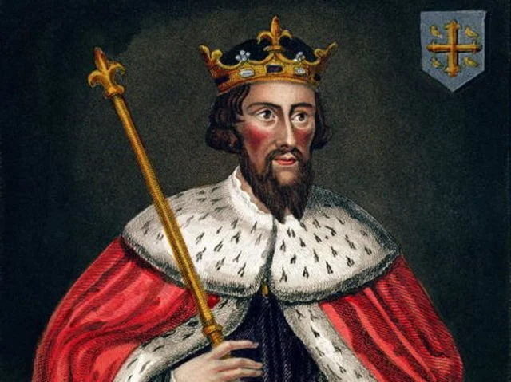
KING Arthur
Legends
made by Daniil Savin

Slide 6
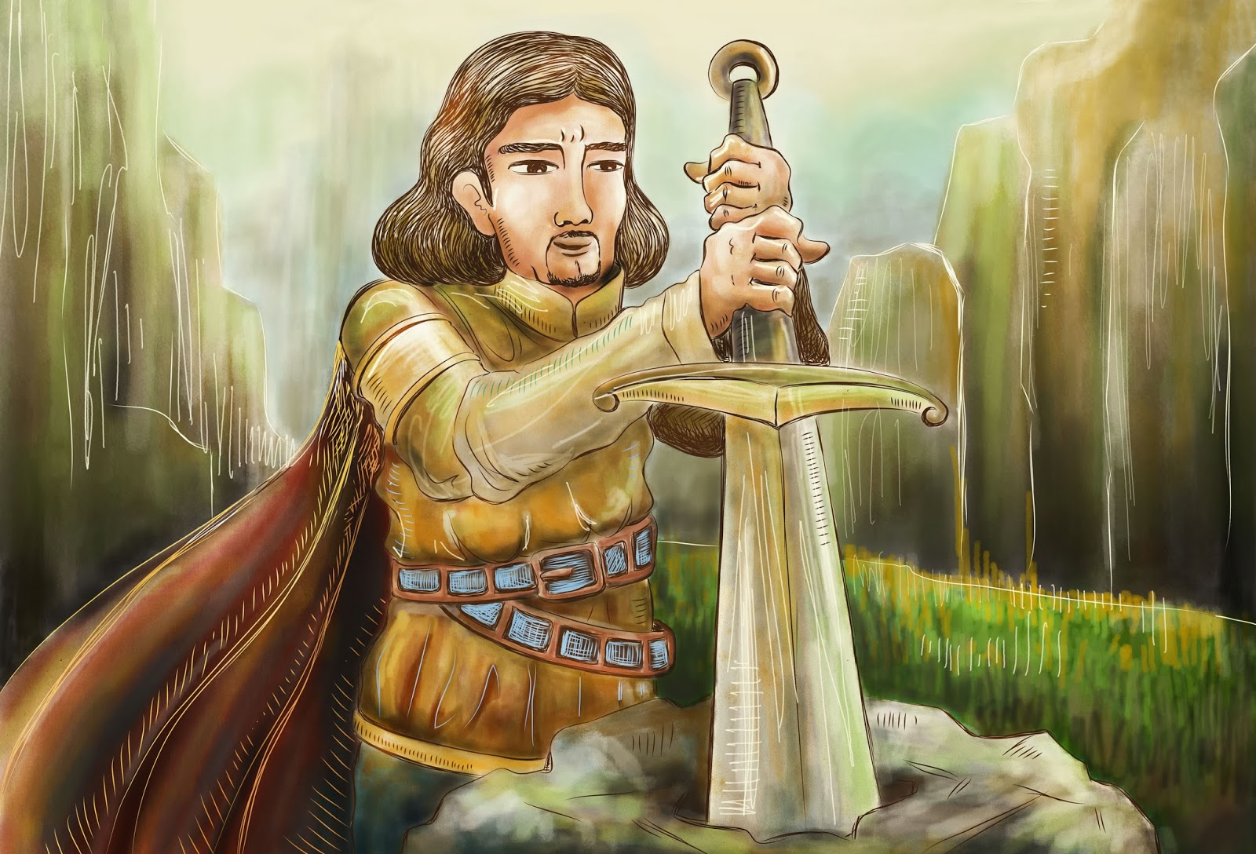
KING Arthur
How Arthur became the king
made by Daniil Savin

Slide 7
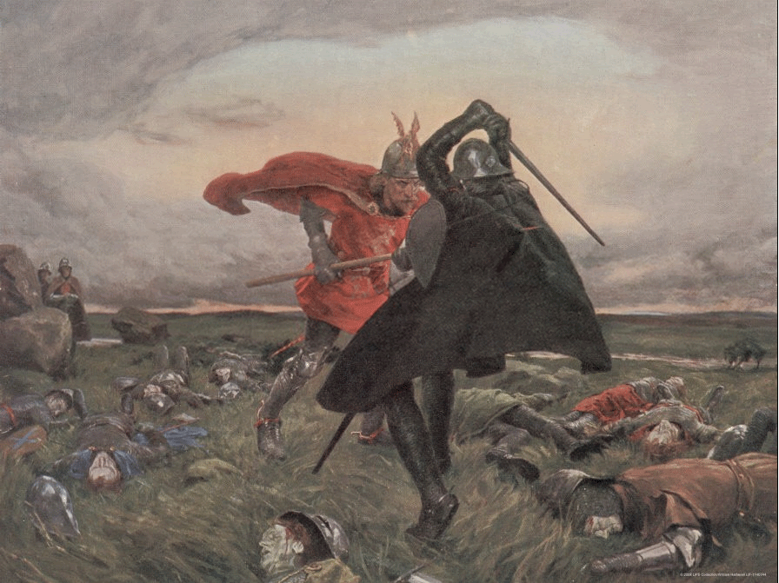
KING Arthur
Battle of Mordred and Arthur on the Kammlan Field
made by Daniil Savin

Slide 8
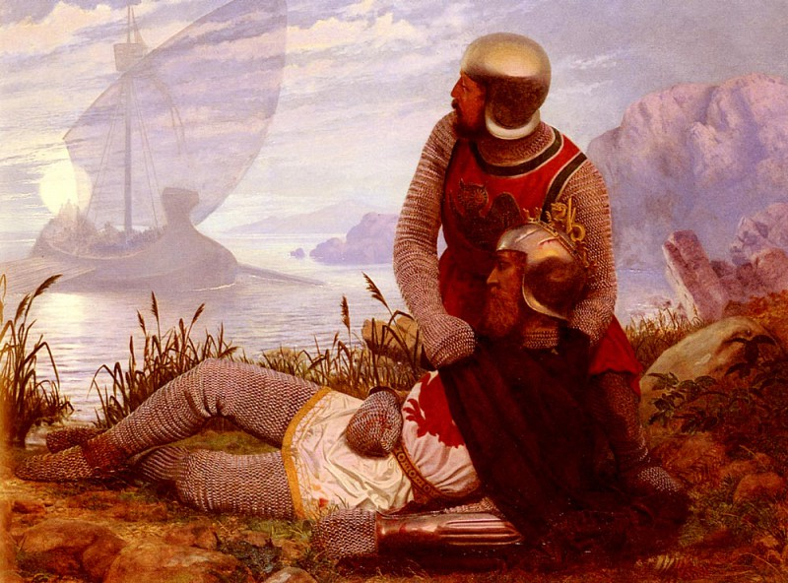
KING Arthur
Arthur's Death
made by Daniil Savin

Slide 9
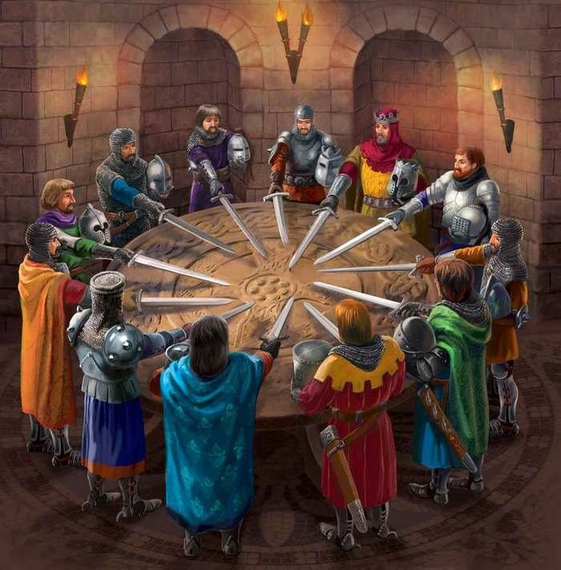
KING Arthur
The Knights of the Round Table
made by Daniil Savin

Slide 10
KING Arthur
The end.
made by Daniil Savin

